Slide 1
Semaglutide per il trattamento dell’obesità: novità ed evidenze dalla real life
Giovanni fantola
Chirurgia metabolica e dell’obesità
arnas brotzu
cagliari

Slide 2
Not conflict of interest

Slide 3
Real-life studies
SCORE (MACE)
LOWER RISK OF MACE AND ALL-CAUSE DEATH IN PATIENTS INITIATED ON SEMAGLUTIDE 2.4 MG IN ROUTINE CLINICAL CARE: RESULTS FROM THE SCORE STUDY (SEMAGLUTIDE EFFECTS ON CARDIOVASCULAR OUTCOMES IN PEOPLE WITH OVERWEIGHT OR OBESITY IN THE REAL WORLD). Smolderen et al. Diabetes, Obesity and Metabolism 2025 Aug.
INFORM (FOOD NOISE)
Impact of food noise after initiating semaglutide treatment: results from a US survey (INFORM) Arnaut et al. 61st European Association for the Study of Diabetes Annual Meeting, 15–19 September 2025, Vienna, Austria. Presentation number: LBA 45 DOI: 10.1007/s00125-025-06497-1

Slide 4
Real-life studies
STEER (MACE, SEMA COMPARED WITH TIRZA)
Semaglutide is associated with a lower risk of cardiovascular events compared with tirzepatide in patients with overweight or obesity and ASCVD and without diabetes in routine clinical practice Results from the STEER study (Semaglutide and Tirzepatide Effects on Cardiovascular Outcomes in People With Overweight or Obesity in thE Real World). Wilson et al.
HOPE (CV EVENTS)
Impact of once-weekly semaglutide on cardiovascular events in adults with overweight or obesity in a real-world Danish population (HOPE) Fernandes et al. 61st European Association for the Study of Diabetes Annual Meeting, 15–19 September 2025, Vienna, Austria. Presentation number: LBA 45 DOI: 10.1007/s00125-025-06497-1

Slide 5
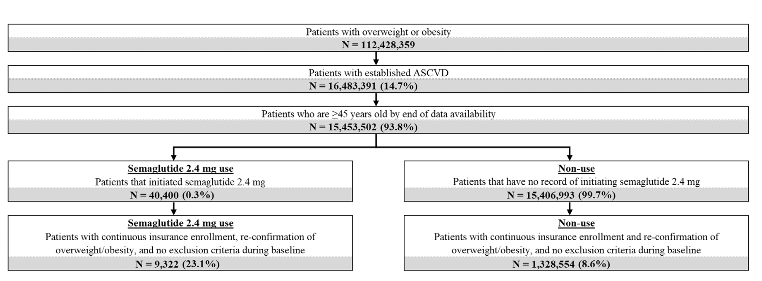
SCORE
REVISED MACE included all-causes mortality
N= 9.322 (SEMA)
VERSUS
N= 18.643 (after propensity match score)
rMACE-5 was defined as any occurrence of MI, stroke (ischemic or haemorrhagic), hospitalisation for heart failure (HF), coronary revascularisation, or all-cause mortality.
rMACE-3 was defined as any occurrence of MI, stroke, or all-cause mortality.
Secondary outcomes included MACE-5 and MACE-3, defined similarly to rMACE-3 and rMACE-5 but replacing all-cause mortality with cardiovascular-related mortality

Slide 6
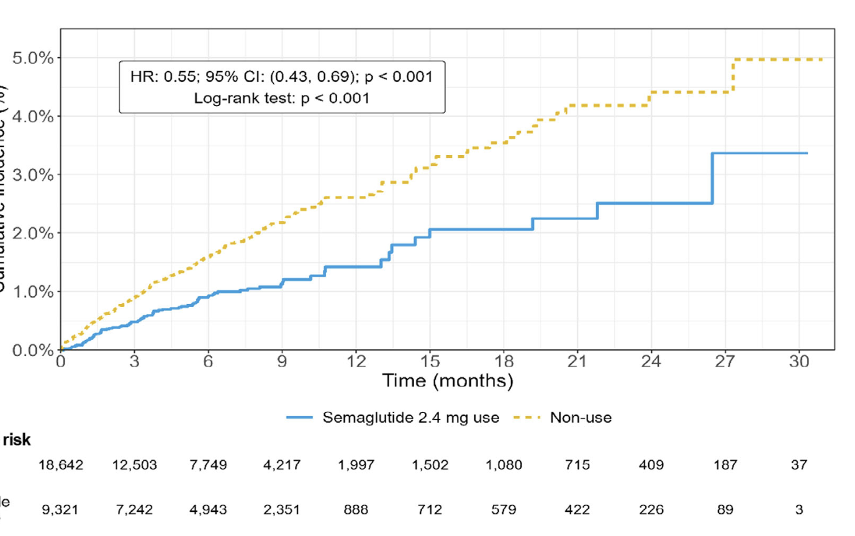
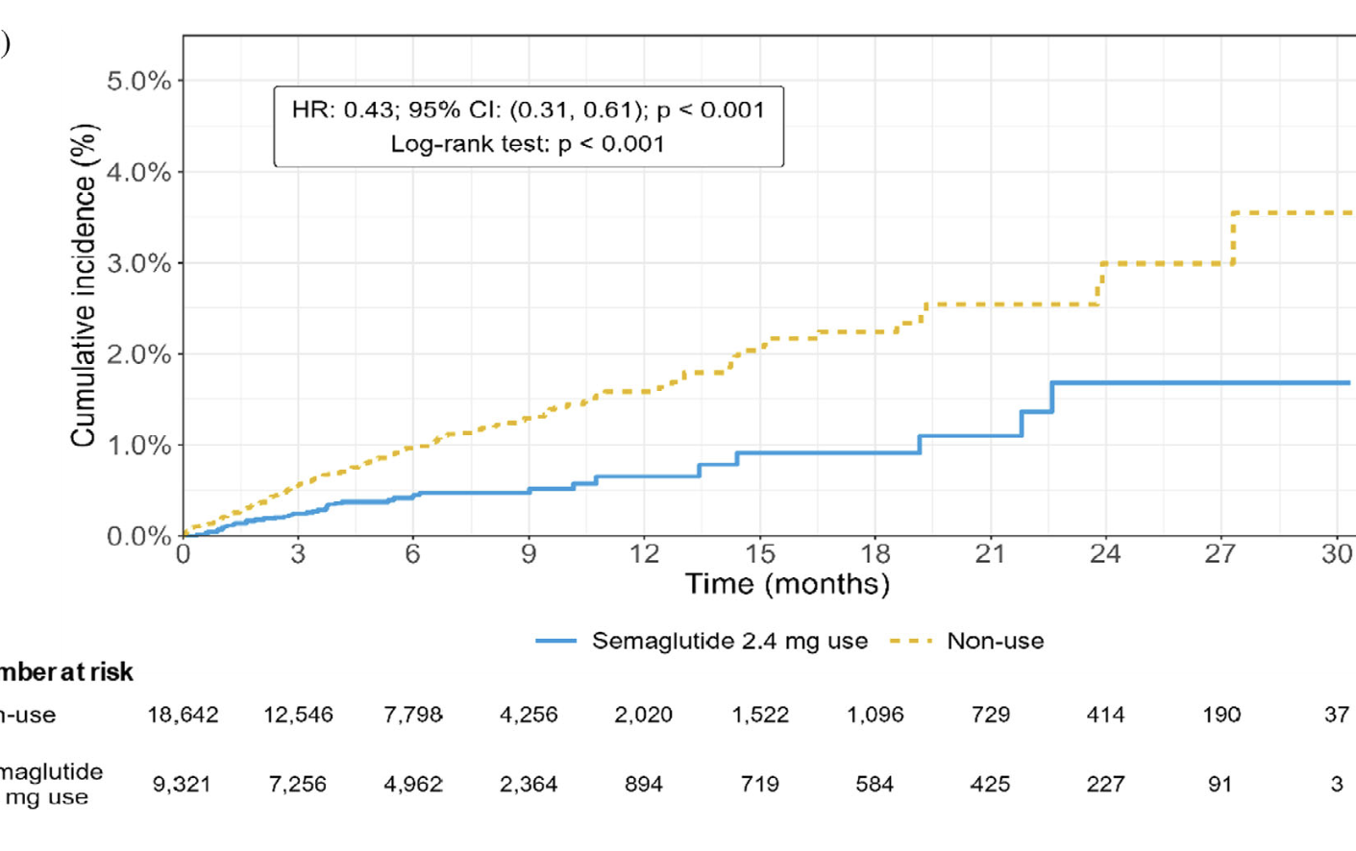
Compared with non-users, semaglutide 2.4 mg use was associated with a 57% lower relative risk of revised-MACE-3 Compared with non-users, semaglutide 2.4 mg use was associated with a 45% lower relative risk of revised-MACE-5
SCORE
R-MACE 5
R-mace 3

Slide 7
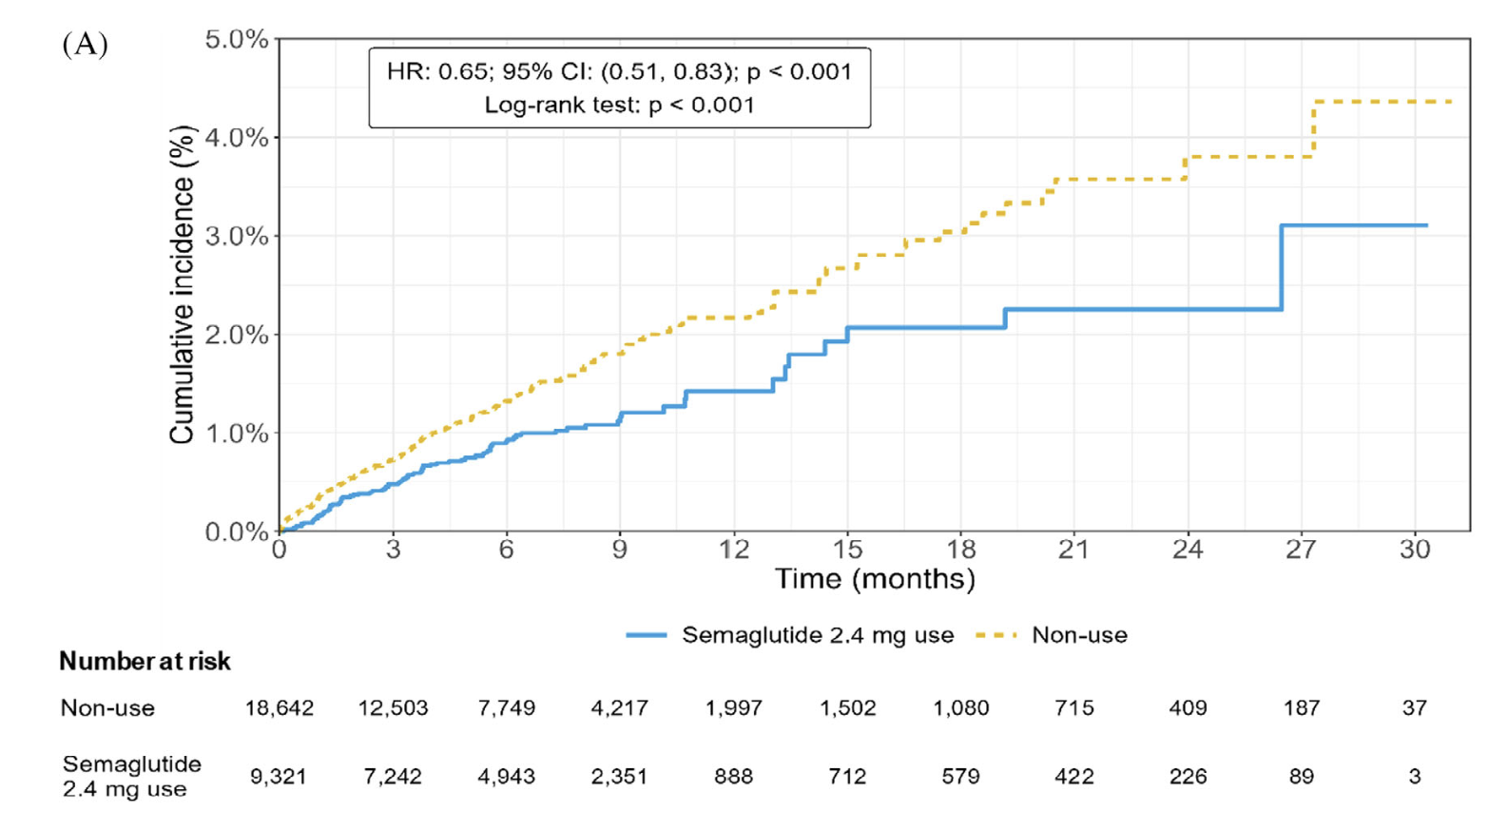
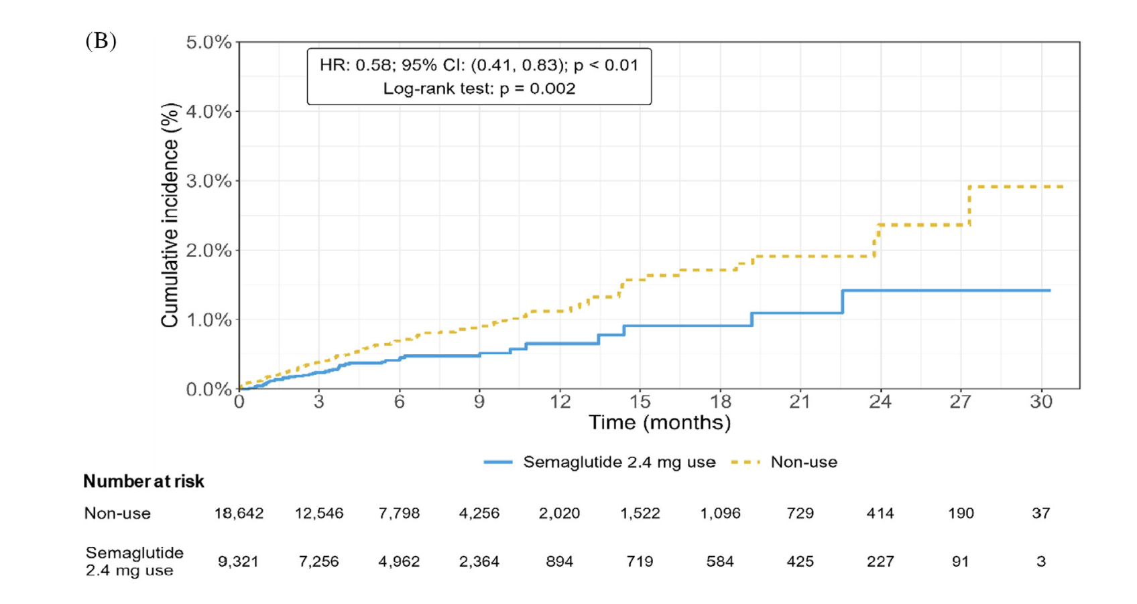
Compared with non-users, semaglutide 2.4 mg use was associated with a 42% lower relative risk of MACE-3 Compared with non-users, semaglutide 2.4 mg use was associated with a 35% lower relative risk of MACE-5
SCORE
mace 3
MACE 5

Slide 8
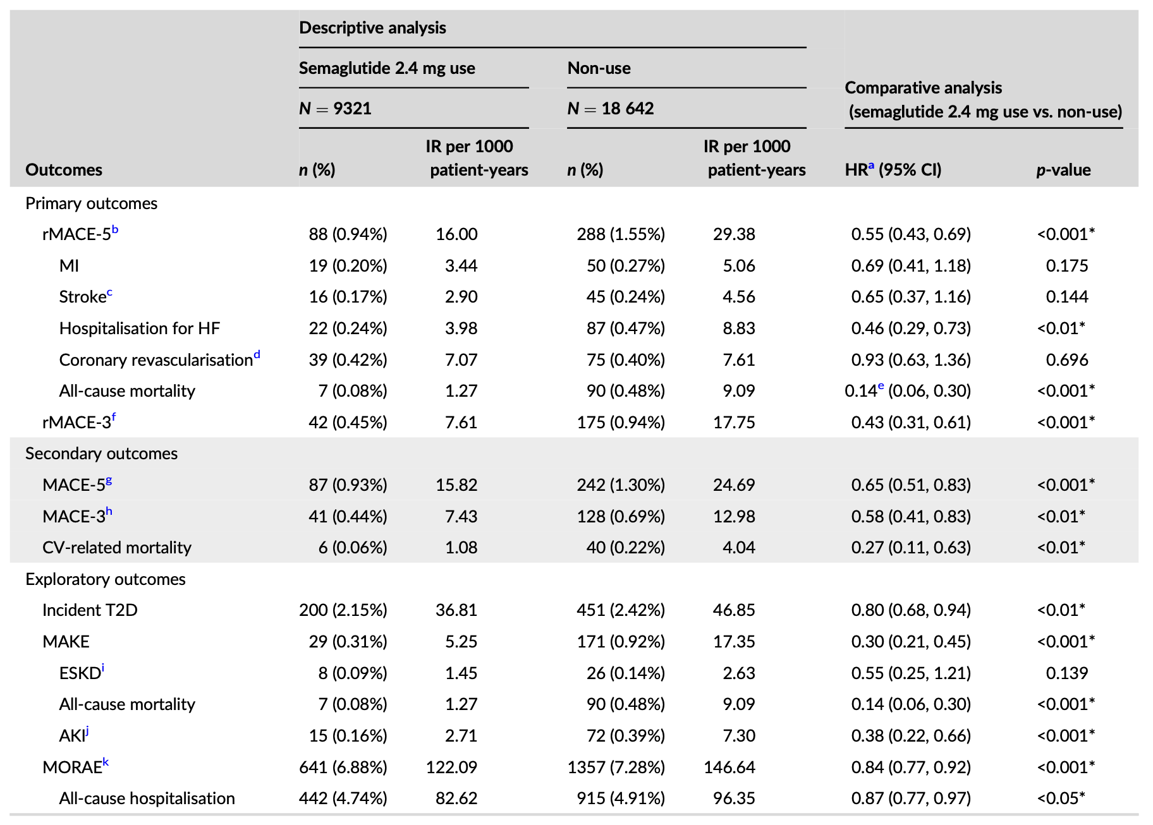
SIGNIFICANT LOWER RISK OF HEART FAILURE HOSPITALISATION AND MORTALITY
SCORE
Significantly lower risk of rMACE-5 by 45% and of rMACE-3 by 57% → mean follow-up of 216 days (semaglutide 2.4 mg use) and 195 days (non-use)
Significantly lower risk of hospitalisation for HF and all-cause mortality
Significantly lower risk of MACE-5 by 35% and of MACE-3 by 42%
Significantly lower risk CV mortality

Slide 9
FOOD NOISE
INFORM
Obsessive and intrusive thoughts about food
550 individuals (from various US regions) currently using semaglutide
Mean age was 53.1 years
86% women
81% at least 4 months

Slide 10
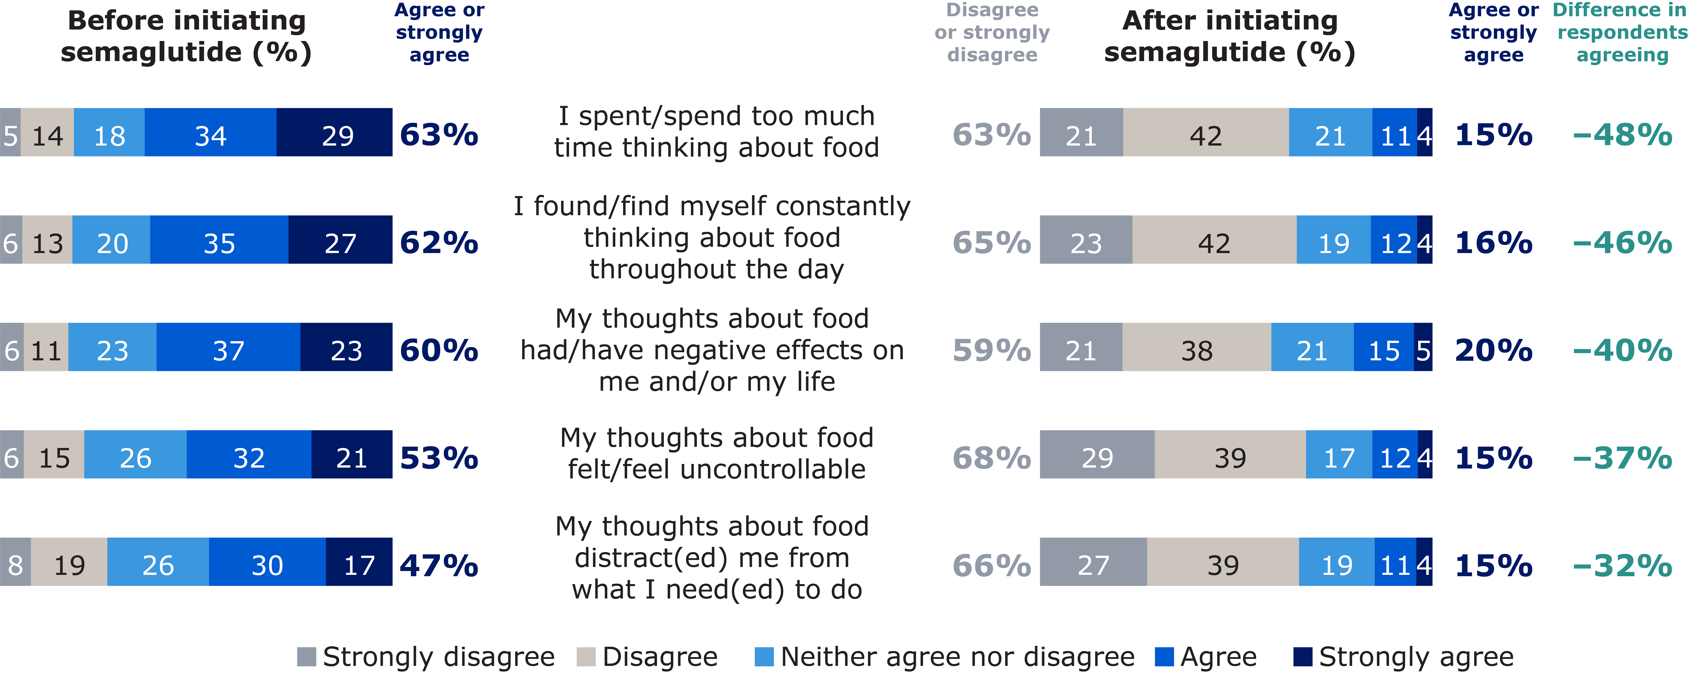
PATIENTS SPENT LESS TIME THINKING ABOUT FOOD
INFORM

Slide 11
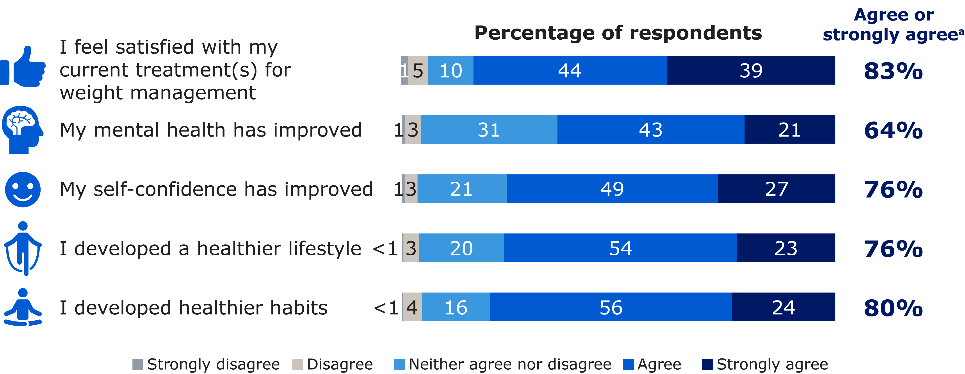
PATIENTS DEVELOPED HEALTHIER HABITS AND LIFESTYLE
INFORM

Slide 12
REAL-WORLD INCIDENCE OF MACE SEMAGLUTIDE (N 14,483 ) VERSUS TIRZEPATIDE (N 10,642)
STEER
≥45 years of age
Overweight/obesity
Established ASCVD
Without diabetes
Initiated semaglutide or tirzepatide (2022 – 2025)
PRIMARY END-POINT
REVISED 5 POINT MACE
REVISED 3 POINT MACE
^{(ALL CAUSES MORTALITY)}
^{MACE/1000 POPULATION}

Slide 13

LOWER RISK FOR SEMA GROUP IN REVISED 3 POINT MACE (ITT)
STEER
Cumulative incidence (%)
Events, n (%) |  | Incidence rate per 1000 patient-years (95% CI) | Mean (SD) follow-up
Tirzepatide | 83 (0.8) | 10.8 (8.61-13.30) | 8.6 (7.1)
Semaglutide | 56 (0.5) | 7.6 (5.70-9.77) | 8.3 (6.4)
Cumulative incidence (%)
6%
7,6% SEMA VERSUS 10,8% TIRZE (-29%)
Tirzepatide
Semaglutide
2%
HR, 0.71 (95% CI, 0.50-0.99); P = 0.046
0%
0
3
6
9
12
15
18
21
24
27
30
No. at risk Tirzepatide Semaglutide
Months
1874
1688
10625
10625
7907
8179
5764
5948
4227
3845
2735
2516
1321
1193
825
670
540
120
220
30
22
17

Slide 14

LOWER RISK FOR SEMA GROUP IN REVISED 5 POINT MACE (ITT)
STEER
Events, n (%) |  | Incidence rate per 1000 patient-years (95% CI) | Mean (SD) follow-up
Tirzepatide | 161 (1.5) | 21.0 (17.87-24.39) | 8.6 (7.1)
Semaglutide | 123 (1.2) | 16.7 (13.85-19.82) | 8.3 (6.4)
Cumulative incidence (%)
Cumulative incidence (%)
1.5%
6%
1.0%
0.5%
Tirzepatide
4%
0.0%
Semaglutide
0
6
9
2%
HR, 0.78 (95% CI, 0.62-0.99); P = 0.040
0%
0
3
6
9
12
15
18
21
24
27
30
No. at risk Tirzepatide Semaglutide
Months
1849
1669
10625
10625
7877
8158
5730
5917
4197
3821
2706
2495
1305
1176
814
662
530
119
215
29
22
17

Slide 15
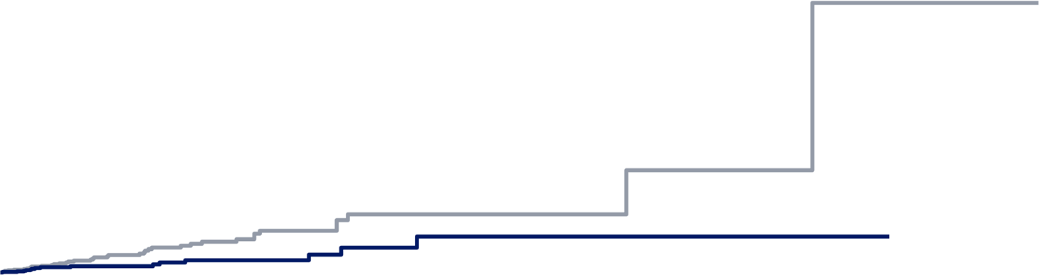
LOWER RISK FOR SEMA GROUP IN REVISED 3 POINT MACE
STEER
Per-protocol sensitivity analysis censored patients at treatment discontinuation (gap in therapy >30 days)
Events, n (%) |  | Incidence rate per 1000 patient-years (95% CI) | Mean (SD) follow-up
Tirzepatide | 39 (0.4) | 10.3 (7.13-13.99) | 4.3 (4.2)
Semaglutide | 15 (0.1) | 4.4 (2.34-7.03) | 3.8 (4.1)
8%
Cumulative incidence (%)
6%
HR, 0.43 (95% CI, 0.24-0.78); P = 0.005
Tirzepatide
SEMA 4,4% VERSUS TIRZE 10,8% (-57%)
2%
Semaglutide
0%
0
3
6
9
12
15
18
21
24
27
30
No. at risk Tirzepatide Semaglutide
Months
281
296
10625
10625
5037
4407
2772
2308
1389
1047
582
546
145
178
73
88
33
12
12
0
1
0
*Revised 3-pont MACE includes myocardial infarction, stroke, and all-cause mortality.
CI, confidence interval; HR, hazard ratio; MACE, major adverse cardiovascular event; SD, standard deviation.
Wilson L, et al. Presented at the European Society of Cardiology (ESC) Congress together with World Congress of Cardiology; Madrid, Spain; August 29 - September 1, 2025.

Slide 16
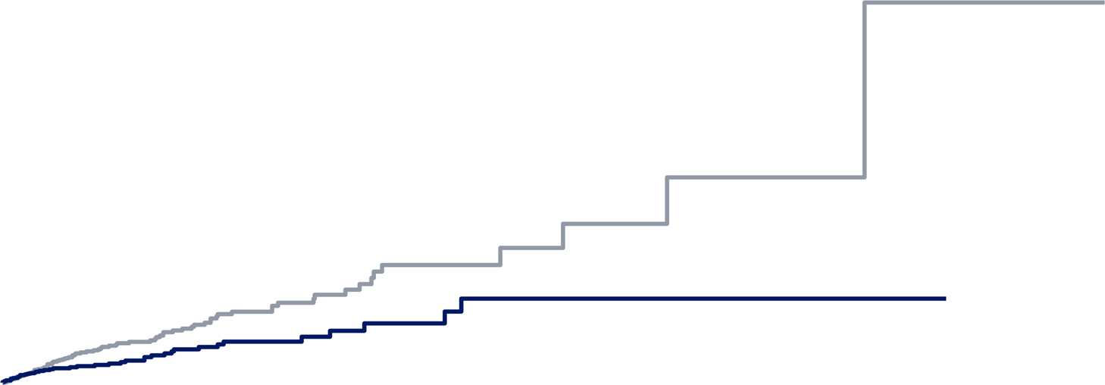
LOWER RISK FOR SEMA GROUP IN REVISED 5 POINT MACE
STEER
Per-protocol sensitivity analysis censored patients at treatment discontinuation (gap in therapy >30 days)
Events, n (%) |  | Incidence rate per 1000 patient-years (95% CI) | Mean (SD) follow-up
Tirzepatide | 80 (0.8) | 21.1 (16.63-26.14) | 4.3 (4.2)
Semaglutide | 42 (0.4) | 12.3 (8.79-16.41) | 3.8 (4.1)
8%
HR, 0.57 (95% CI, 0.39-0.83); P = 0.003
Tirzepatide
Cumulative incidence (%)
6%
³ Months
2%
Semaglutide
0%
0
3
6
9
12
15
18
21
24
27
30
No. at risk Tirzepatide Semaglutide
Months
280
294
10625
10625
5020
4403
2759
2303
1380
1045
577
544
144
177
72
87
33
12
12
0
1
0

Slide 17

7113 SEMA VERSUS 21339 CONTROL
HOPE
Aged ≥45 years
Hospital diagnosis of overweight or obesity (BMI ≥25 kg/m²) in the Danish National Patient Register during index period (1 Jan 2012–31 Dec 2022)
For the semaglutide group, ≥1 prescription for once-weekly semaglutide for weight management in Danish Prescription Register (12 Dec 2022–31 Oct 2024)
84% women
ENDPOINTS:
- 5P MACE
- 3P MACE

Slide 18
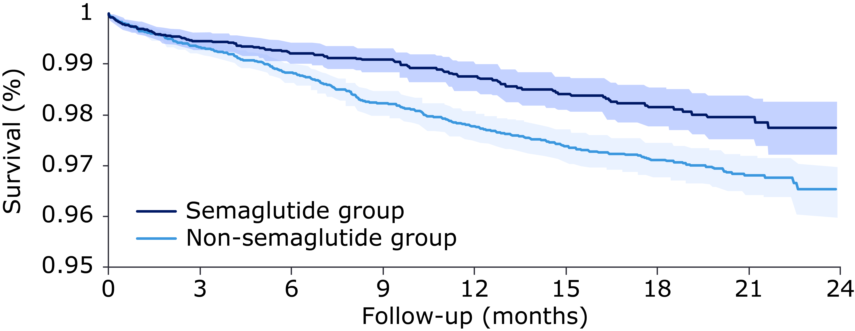
LOWER RISK OF 5P MACE
HOPE
Event rate
Semaglutide group: 1.4% Non-semaglutide group: 2.3%
HR: 0.64 (0.51–0.79)
Incidence of 5P-MACE per 1000 person-years
Semaglutide | 12.8
Non-semaglutide | 20.2
Absolute risk reduction | 7.4
Maximum follow-up was 23.5 months

Slide 19
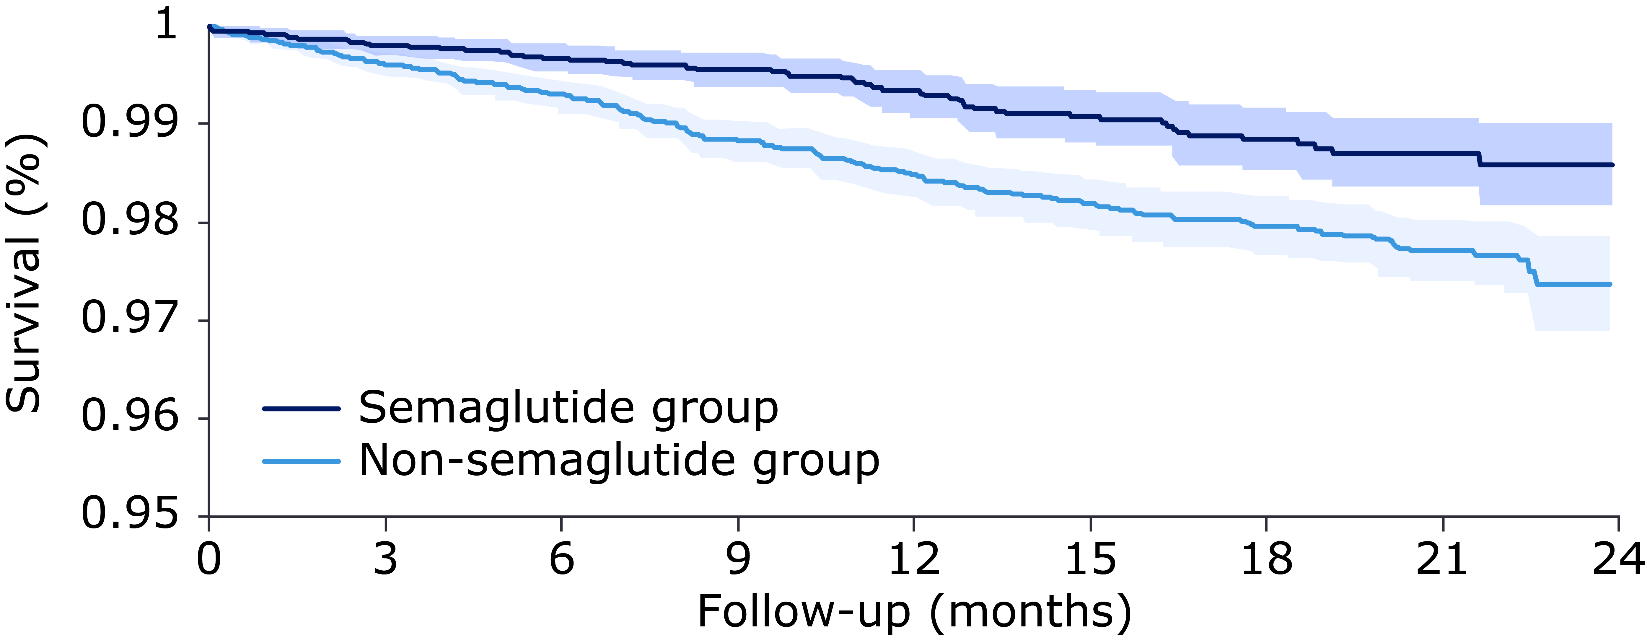
LOWER RISK OF 3P MACE
HOPE
Event rate
Semaglutide group: 0.8% Non-semaglutide group: 1.6%
HR: 0.53 (0.40–0.70)
Incidence of 3P-MACE per 1000 person-years
Semaglutide | 7.4
Non-semaglutide | 14.0
Absolute risk reduction | 6.6
Maximum follow-up was 23.5 months

Slide 20
CONCLUSION
Real-life studies were focused on semaglutide benefit in patient with obesity for cardiovascular events (CV: MACE), from SELECT
In our experience, SEMA was adopted to treat obesity class I (or II) with comorbidity (i.e. cardiovascular)
Comparing with dual-agonist could be better for long-term CV prevention instead lower weight-loss
Need long term treatment (MACE prevention)? → SEMA
Need rapid weight loss? TIRZA

Slide 21
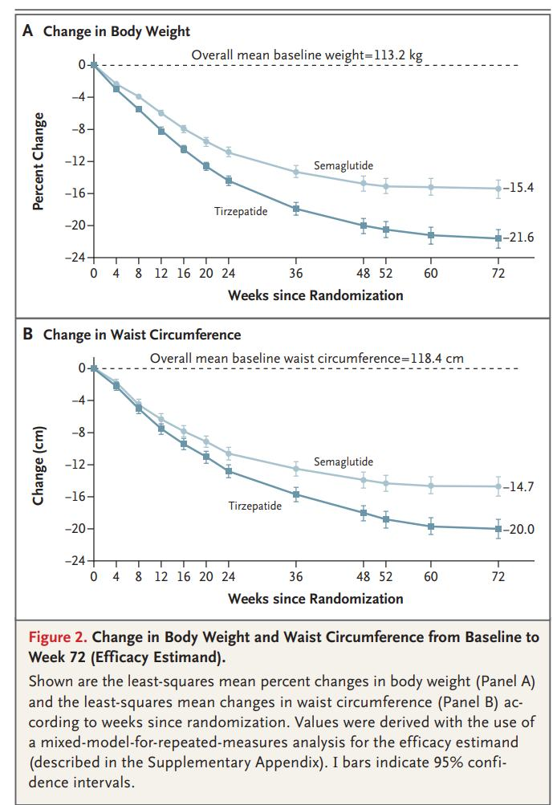
CONCLUSION
SEMAGLUTIDE OR TIRZEPATIDE?
Tirzepatide as Compared with Semaglutide for the Treatment of Obesity
Aronne et al., SURMOUNT-5 Trial I
NEJM 2025

Slide 22
giovannifantola@aob.it

